Slide 1

The effect of operating hours on ratings for restaurants in FL & CA
GB 760 Group #22
By: Stefan Lochner, Aija Kopca, Trilochan Lalam, Xinyi Qiu and Yogesh Ramachandra
Notes:
Take 10 seconds - Aija

Slide 2
The Basics/Background
The Question:
Do restaurants in FL and CA with longer operating hours receive better reviews (both ratings and comments)?
Our hypothesis:
Businesses with longer operating hours receive better
reviews (with positive comment specific pointing on longer hours) and
higher rating score on Yelp.
Notes:
Take 45 seconds - Aija
Mention the basics of what we’re doing
What we’re looking into
Where we’re grabbing the data
How we plan to analyze it

Slide 3
Primary Data
Primary data:
- Yelp dataset (Review Table).
- Integrated the Python environment with SQL workbench for the data
Notes:
45 seconds - Yogesh

Slide 4
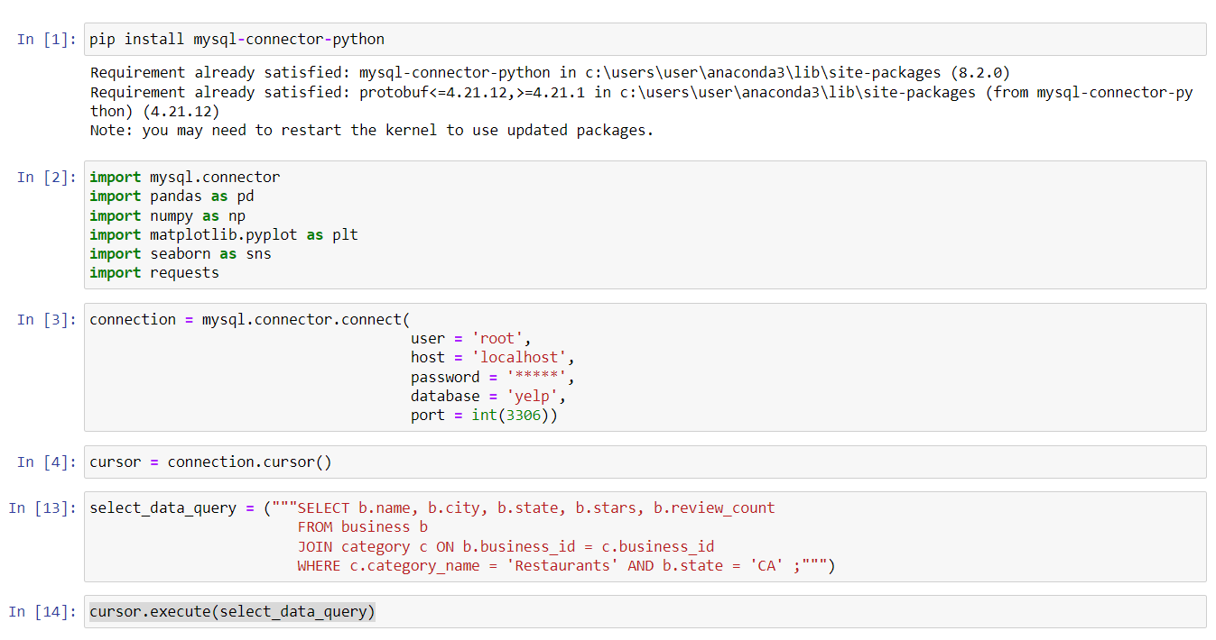
Py - SQL Integration Code

Slide 5
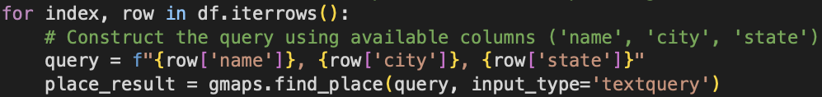
Secondary Data - Google Maps API
Secondary data:
- Google Maps API
Using Google Maps API to collect operation hours data for each restaurants in FL & CA, join this dataset with the Review table in Yelp dataset by restaurant name, city, and state.
Notes:
45 seconds - Stefan

Slide 6
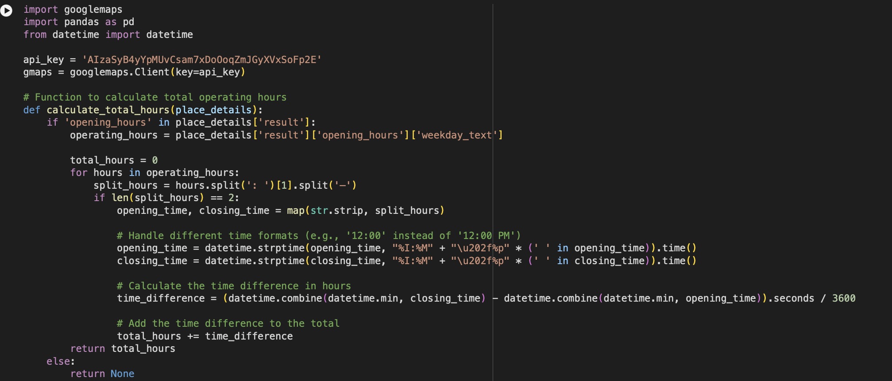
Snippet of googlemaps API

Slide 7
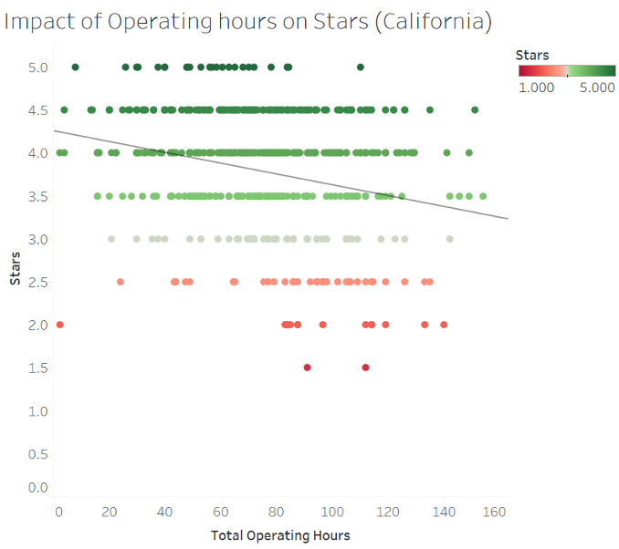
California Rating Scores
Scatter plot between total operating hours and stars of restaurants in california
Trend line signifies there is negative relation between rating and total operating hours
Restaurants that got higher rating have total operating hours between 50-80 hrs
Most restaurants that have lower rating have operating hours more than 80 hrs
Notes:
Take 1 minute - Trilochan

Slide 8
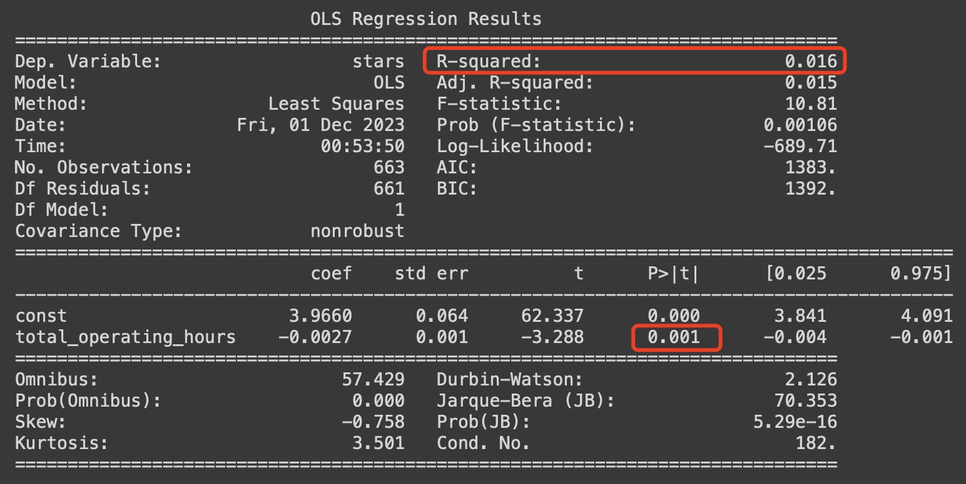
Evidence from California focus on rating scores
Regress total hours (X) on rating scores (Y):
Y_ca = 3.966 - 0.0027X + ε
- Number of observations:663
- Df Residuals = 661
- R-squared = 0.016
- P > t = 0.001
By coefficient:
- Highly significant in 99.9%.
- Negative impact of x on y.
Notes:
Take 1 minute - Sandra

Slide 9
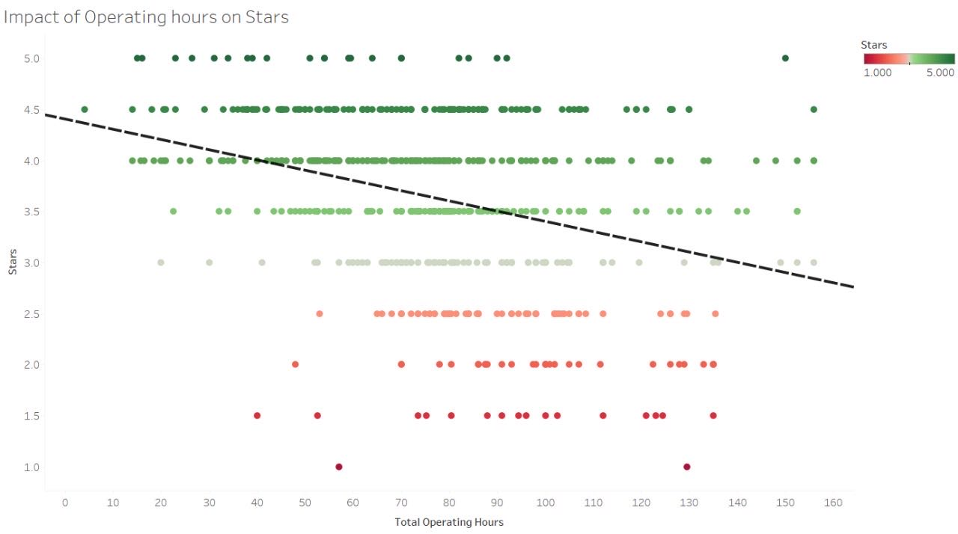
Florida Rating Scores
Scatter plot between total operating hours and ratings of restaurants in Florida
Trend line signifies there is negative relation between rating and total operating hours
Restaurants operating fewer than 40 hrs per week do not receive lower ratings.
Notes:
Take 1 minute - Trilochan

Slide 10
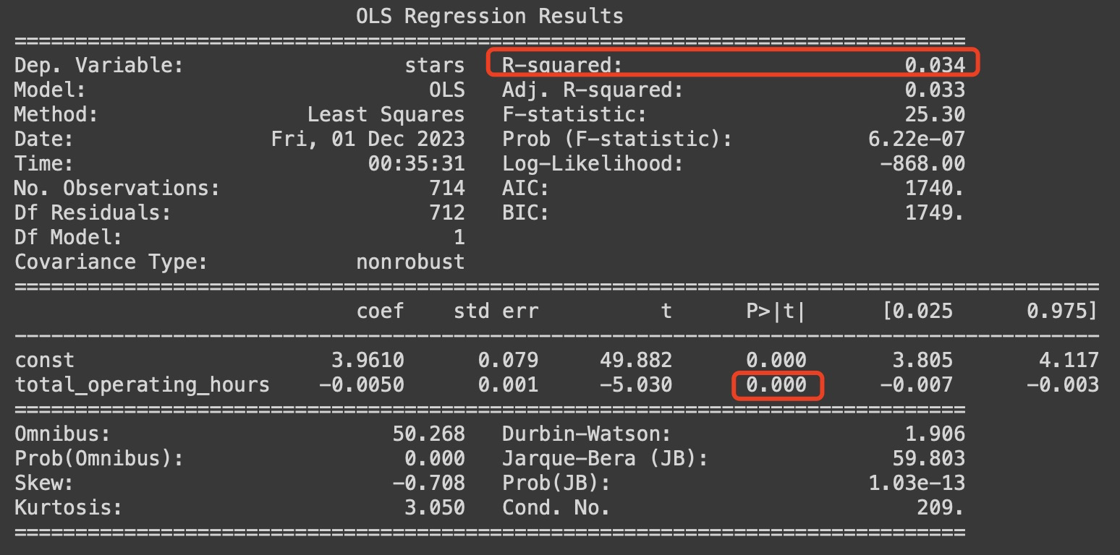
Evidence from Florida focus on rating scores
Regress total hours (X) on rating scores (Y):
Y_FL = 3.961 - 0.005X + ε
- Number of observations:714
- Df Residuals = 712
- R-squared = 0.034
- P > t = 0
By coefficient:
- Highly significant in approximately 100%.
- Negative impact of x on y.
Notes:
Take 1 minute - Sandra

Slide 11
Conclusion
Question: Does operation hour have an effect on ratings for business?
Hypothesis: Longer operation hours should result to a higher rating for businesses on Yelp
Result:
- We have failed to prove our hypothesis
- Opposite result: longer operation hours -> worse ratings
- Although our p-value is highly significant -> our OLS trends only explain 3%-5% of the data.
Notes:
Take 1 minute - Trilochan

Slide 12
Intuition behind
Challenges
High significance but fail the test??
Too many ε in our regression model that is correlated with our x
Food quality, services, etc.
Improvements?
Multi-regression or IV regression
Data scraping
Information missing differently appears when using multiple APIs.
Huge database results expired API license.
Time and effort to put together.
Modelling.
Notes:
Take 1 minute - Sandra

Slide 13
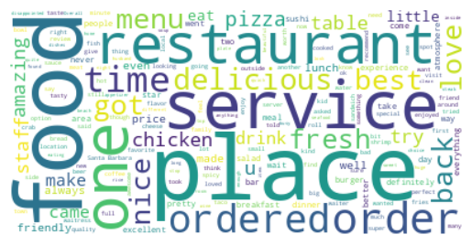
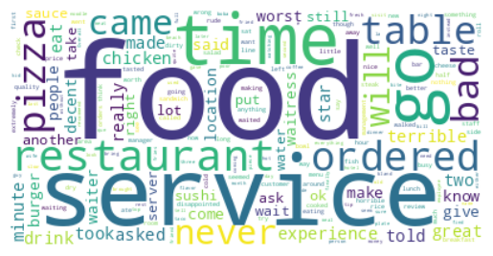
Recommendations for Future Analysis
Extend the search past CA and FL.
Focus research on the negative words that appear most often in reviews.
Service
Food
Time
(1)
(2)
Notes:
Take 30 seconds
Where to go from here slide. Negative reviews show that the op negative review focus on x words.

Slide 14
Thank You For Your Listening!
Questions?

